Slide 1


AI-Driven Personalized Nutrition: Revolutionizing Health with Technology
Welcome to the future of nutrition, where technology meets personalized healthcare! This presentation explores the revolutionary impact of AI-driven personalized nutrition, highlighting its potential to transform how we approach health and well-being.
by Kollipara Jaswanth

Slide 2

Introduction
1
Importance of Personalized Nutrition
Personalized nutrition recognizes the unique needs of each individual, considering factors like genetics, lifestyle, and health goals. It's a paradigm shift from one-size-fits-all approaches, aiming to achieve optimal health outcomes tailored to individual needs.
2
Differences Between Traditional and Personalized Nutrition
Traditional dietary advice often relies on general guidelines and recommendations, while personalized nutrition utilizes advanced data analysis and AI to provide tailored plans based on individual characteristics and preferences.
3
Benefits of Tailored Dietary Plans
Personalized nutrition offers a plethora of benefits, including improved health outcomes, increased adherence to diet plans, enhanced user engagement, and better understanding of individual health needs.
4
Objective
This presentation explores how AI is revolutionizing nutrition planning, moving beyond generic guidelines to offer personalized dietary recommendations that empower individuals to take control of their health.

Slide 3
Applications of Nutritional Science in AI
Integration of Nutritional Science
AI Algorithms and Models
Examples
AI-powered meal planners utilize sophisticated algorithms to create personalized meal plans based on individual needs and preferences. Predictive models can identify potential nutrient deficiencies by analyzing dietary patterns and health data.
AI applications leverage nutritional science to understand the role of essential nutrients in the body, dietary guidelines for various populations, and recommended dietary allowances (RDAs). This knowledge is crucial for creating effective and safe personalized plans.
AI algorithms, such as machine learning techniques, are employed to analyze vast amounts of data, identifying patterns and generating personalized recommendations. Supervised learning models use labeled data to predict nutritional outcomes, while unsupervised learning models discover hidden relationships within the data.

Slide 4

Data Collection and Management
1
Types of Health Data
Personalized nutrition relies on a diverse range of health data, including personal health records, genetic information, lifestyle data, dietary preferences, and restrictions. This data provides a comprehensive picture of an individual's health and nutritional needs.
2
Data Sources and Collection Methods
Data is collected through wearables, mobile apps, and health surveys, providing insights into dietary habits, physical activity levels, and other health indicators. This data is then processed and analyzed by AI algorithms to generate personalized recommendations.
3
Data Privacy and Security
Ensuring data privacy and security is paramount in personalized nutrition. Encryption, anonymization techniques, and consent management protocols are crucial to protect sensitive health data and maintain user trust.

Slide 5
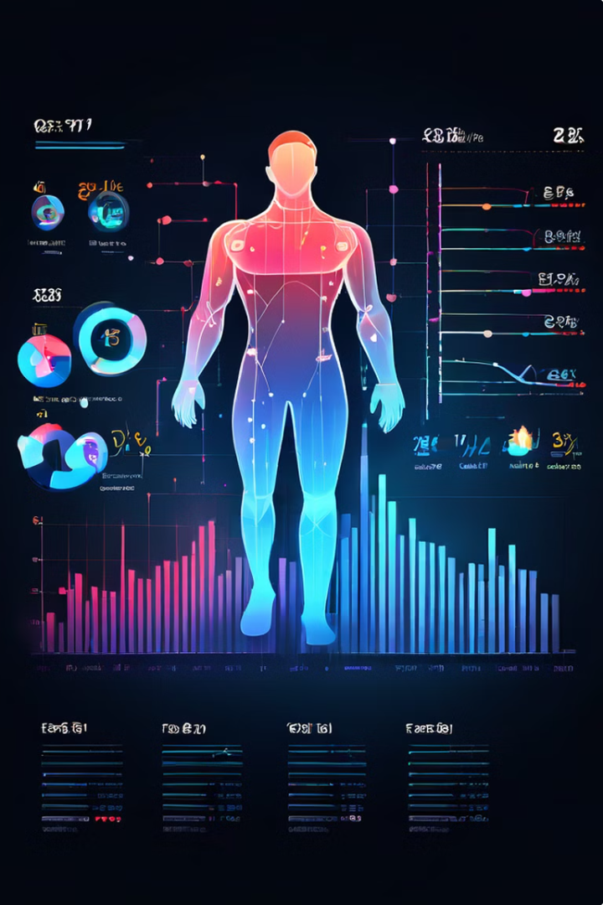
Data Analytics for Health Insights
Technique
Description
Example
Data Mining
Extracting meaningful patterns and insights from large datasets.
Identifying common dietary patterns among individuals with specific health conditions.
Predictive Analytics
Using historical data to forecast future outcomes and trends.
Predicting the likelihood of developing a nutrient deficiency based on dietary patterns and lifestyle factors.
Pattern Recognition
Identifying recurring patterns and relationships within data.
Recognizing associations between specific food groups and health markers, such as blood pressure or cholesterol levels.

Slide 6
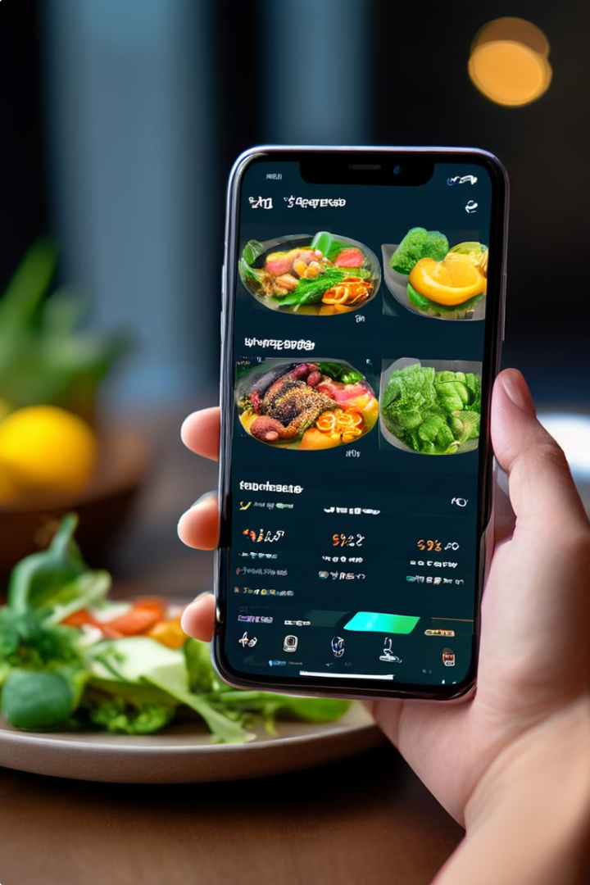



Personalization of Nutrition Plans
AI-Driven Personalization
AI algorithms analyze health data to create personalized nutrition plans tailored to individual caloric needs, nutrient requirements, and specific health goals. These plans are dynamic and adaptable, adjusting to real-time data and feedback from wearables and apps.
Case Studies
Nutrigenomics-based diet plans, which consider an individual's genetic makeup, are increasingly popular. AI-driven weight management apps provide personalized guidance and support, leveraging data analysis to optimize weight loss journeys.
Benefits
Personalized nutrition plans lead to improved health outcomes, increased adherence to diet plans, enhanced user engagement, and better overall health management. Individuals are empowered to take control of their health and make informed decisions about their nutrition.

Slide 7
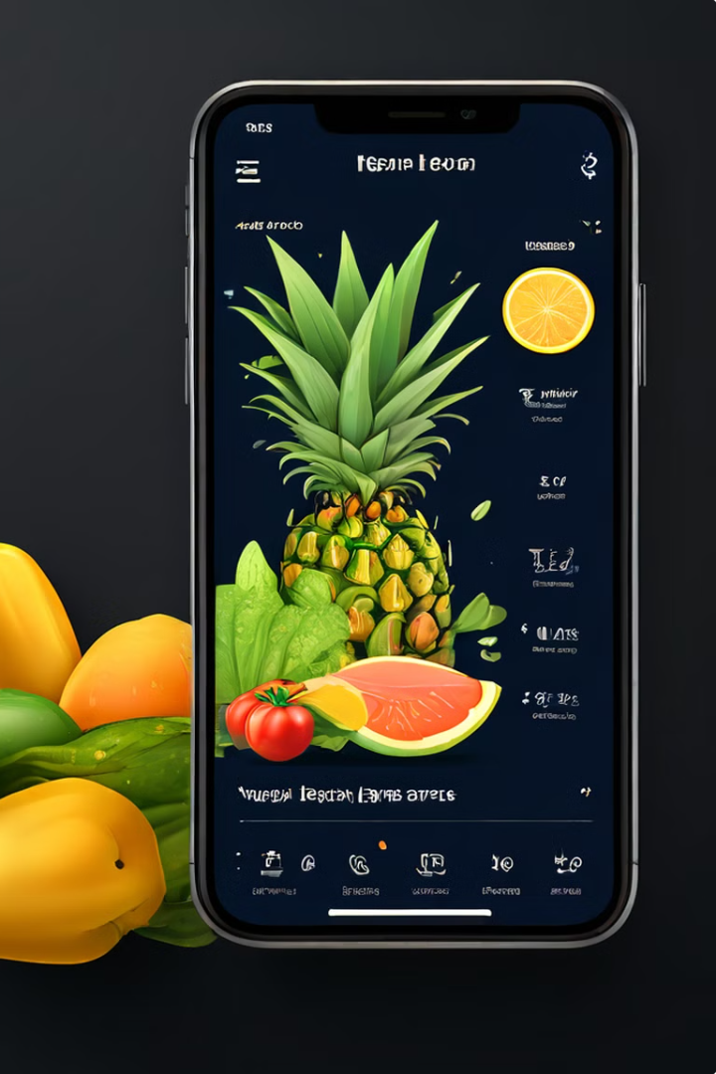
UI/UX Design Considerations for Healthcare Interfaces
User-Centric Design
Intuitive and accessible interfaces are crucial for user engagement. Simplifying complex health data and providing clear navigation, user-friendly data visualization, and personalized recommendations are essential for effective user experience.
Features and Functionalities
Interactive meal planning tools, progress tracking dashboards, and personalized recommendations contribute to a seamless and engaging user experience. Drag-and-drop meal planners, real-time progress visualization, and interactive charts enhance user interaction.
Challenges
Addressing diverse user needs, including accessibility for elderly users, customization options, and user preferences, is paramount in designing healthcare interfaces. Ensuring that the interface is tailored to individual needs and preferences is essential for long-term engagement.

Slide 8
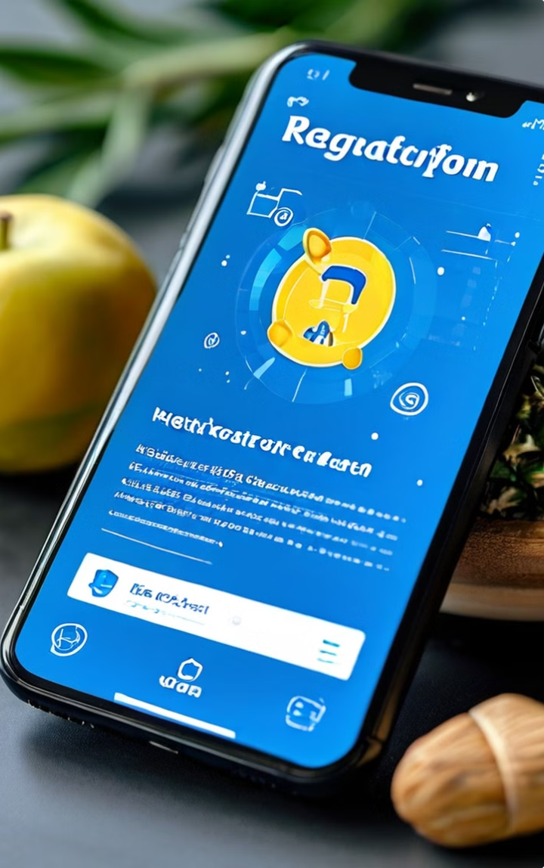



Regulatory Compliance in Health Technology
Regulatory Frameworks
Key regulations such as GDPR (General Data Protection Regulation), HIPAA (Health Insurance Portability and Accountability Act), and FDA (Food and Drug Administration) guidelines govern the use of AI in health technology.
Ensuring Compliance
Compliance strategies, regular audits, compliance software, and user education are essential for ensuring adherence to regulations. Data handling and processing must be transparent, secure, and compliant with all relevant laws and guidelines.
Ethical Considerations
AI in healthcare must be developed and deployed ethically, ensuring transparency, fairness, and accountability. Bias in AI models must be addressed, and communication with users regarding AI decisions should be clear and understandable.

Slide 9
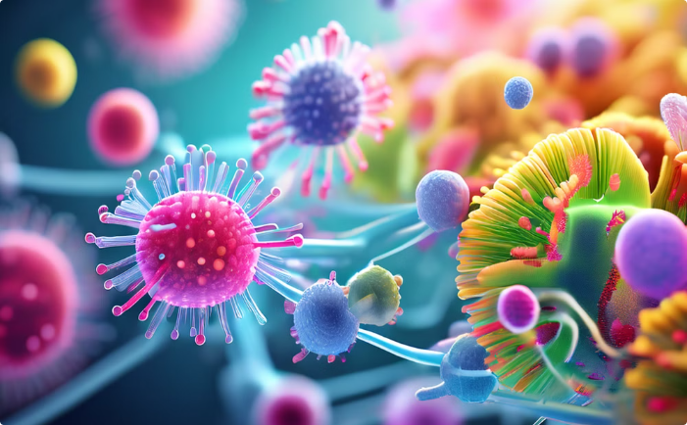

Future Trends and Opportunities
Advancements in AI and Nutrition
Opportunities for Research and Development
AI-driven microbiome analysis, real-time nutrient tracking, and integration with other health technologies, such as telehealth and personalized medicine, are transforming the field of nutrition. Smart kitchen devices and AI-powered virtual assistants are further blurring the lines between technology and health.
AI offers exciting opportunities for research and development in various areas, including AI for mental health nutrition, AI for chronic disease management, and AI-powered food production and distribution. Collaboration with healthcare providers, hospitals, and research institutions is crucial for driving innovation in this field.

Slide 10
Contact, Discussion, and Thank You
Contact Us: Jaswanth Kollipara
Thank you all for your time and attention. We hope this presentation has provided valuable insights into the capabilities and future of Personal Finance Manager.
or email us at info@kjaswanth28@gmail.com Please feel free to raise your hand or use the discussion chat to participate in the Q&A session.
We welcome your questions and feedback.

